Slide 1
Excel Based Decision Support System

Slide 2
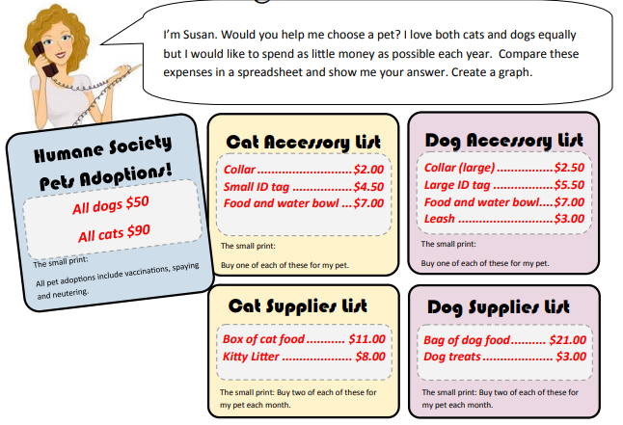
Dog or Cat?

Slide 3
Analysis of owing a Dog and a Cat for the first year
 | Cat | Dog
Initial
Purchase | $ 90.00 | $ 50.00
Collar | $ 2.00 | $ 2.50
ID tag | $ 4.50 | $ 5.50
Bowl | $ 7.00 | $ 7.00
Leash | $ - | $ 3.00
Total | $ 103.50 | $ 68.00
Monthly
Food | $ 11.00 | $ 21.00
Litter | $ 8.00 | $ -
Treats | $ - | $ 3.00
Subtotal | $ 19.00 | $ 24.00
Total | $ 38.00 | $ 48.00
 | Cat | Dog
First Year's | $ 559.50 | $ 644.00

Slide 4
Findings
Dog has lower initial cost
Cat has lower monthly Expenses
Cat is cheaper overall in the first year

Slide 5
DECESION MATRIX
Criteria | Cat | Dog
Initial Cost | 5 | 8
Monthly Cost | 8 | 6
First-Year Cost | 9 | 5
Maintenance | 8 | 6
Flexibility | 6 | 8
Total | 36 | 33
Why Cat scored higher
Lower yearly cost
Lower maintenance
More affordable long-term
Why Dog scored higher in some areas
Lower initial cost
More flexible socially

Slide 6
Weighted Analysis
Citeria | Weight | Cat | Cat Weighted | Dog | Weighted Cat
Initial Cost | 20% | 5 | 1 | 8 | 1.6
Monthly Cost | 25% | 8 | 2 | 6 | 1.5
First-Year Cost | 30% | 9 | 2.7 | 5 | 1.5
Maintenance | 15% | 8 | 1.2 | 6 | 0.9
Flexibility | 10% | 6 | 0.6 | 8 | 0.8
Total |  |  | 7.5 |  | 6.3

Slide 7
Weighted Analysis Conclusion
Based on weighted decision analysis, the cat option performs better overall because long-term affordability and maintenance were prioritized more heavily than initial purchase cost.

